Slide 1
Random walking
2D & 3D LANDSCAPE

Slide 2
Morphing Part 1
06/17/22 Slide #3~ #8

Slide 3
Process of Morphing
In this step, we chose Group 1 which includes Pullover, Trouser, and Coat as the original pictures. Picture Pullover was morphed to Trouser first in which 9 new middle pictures were generated. These 9 new middle pictures then was morphed to Coat. Each morphing from one new middle picture to Coat generated 9 new middle pictures. We ordered all pictures in a way that Pullover was at top left corner, Trouser was at top right corner, and 11 identical Coat pictures were at bottom row, and all other middle pictures were located between corresponding two original pictures. That’s how a 11 times 11 pictures matrix is made of.
In order to test if morphing from one picture to the other and morphing backwards have a mirror-symmetrical relationship with morphing backwards, we considered all combination possibilities. By comparing the first row of slide 3 & 5, the answer is no. Furthermore, by Comparing the first column of slide 3 & the last column of slide 5, we found the middle picture is even different for morphing from Pullover to Coat.

Slide 4
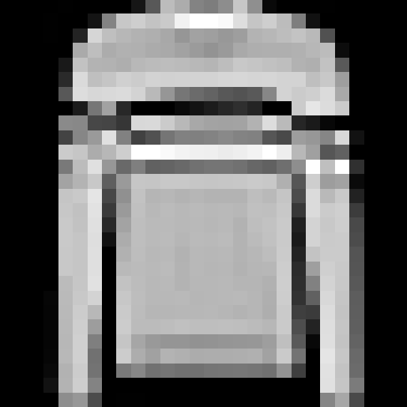
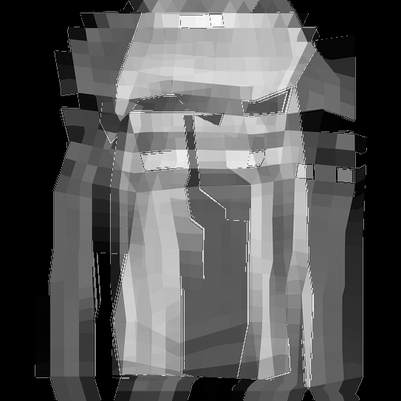
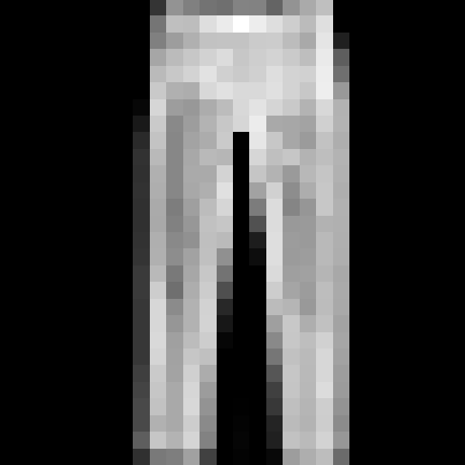

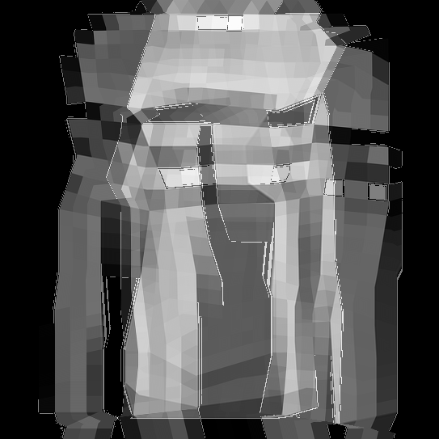

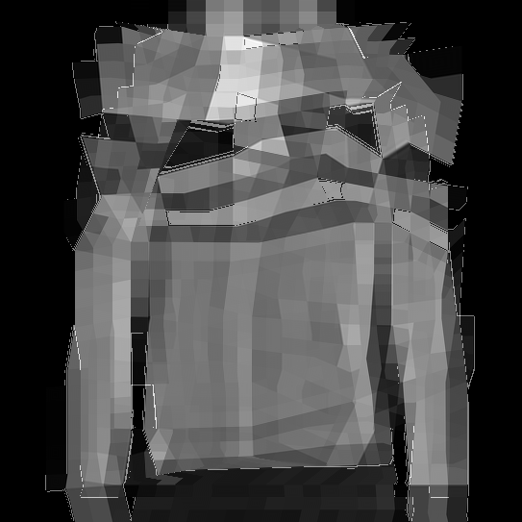
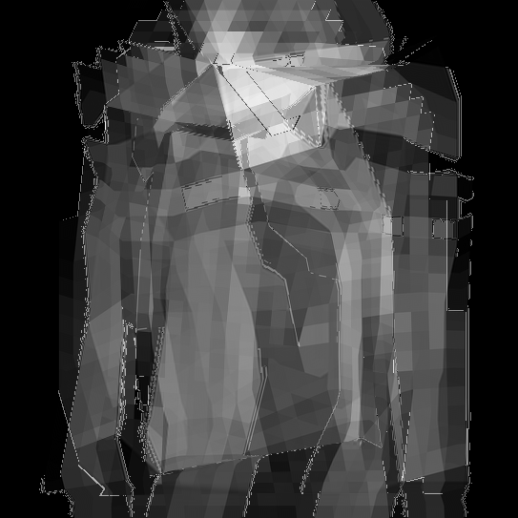
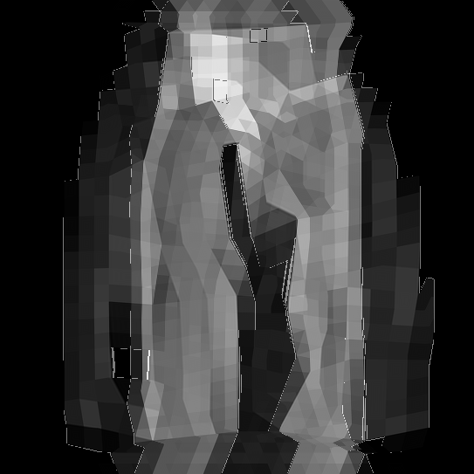
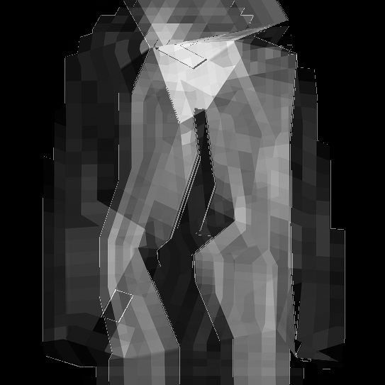
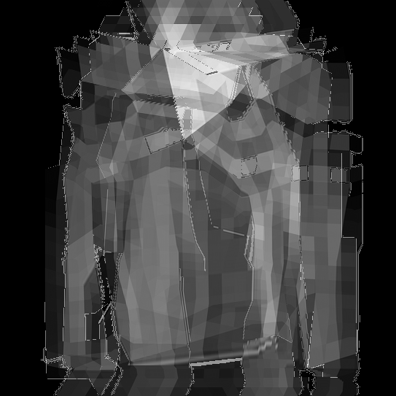
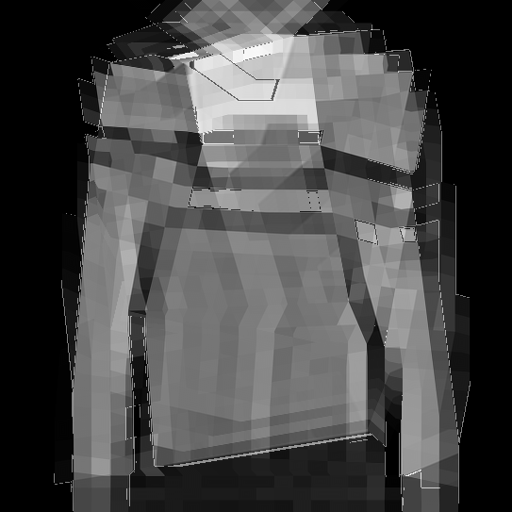
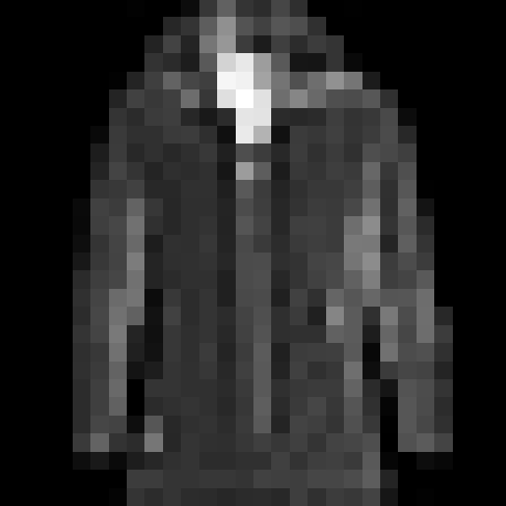

Group 1
Pullover & Trouser → Coat VS. Trouser & Pullover → Coat
5 Pullover
16 Trouser
16 Trouser
5 Pullover
19 Coat
19 Coat
19 Coat
19 Coat
19 Coat
19 Coat

Slide 5
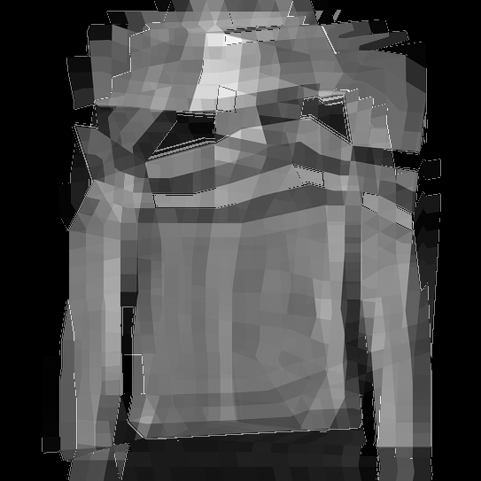
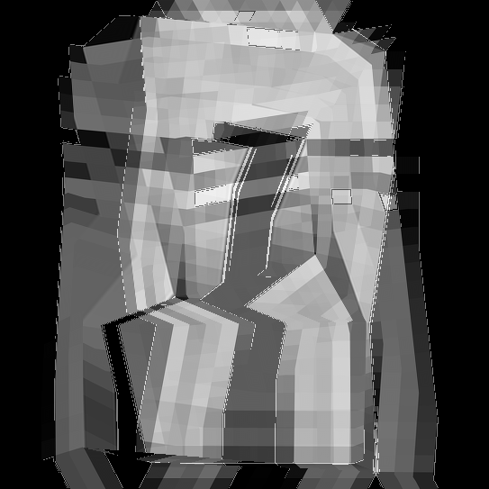
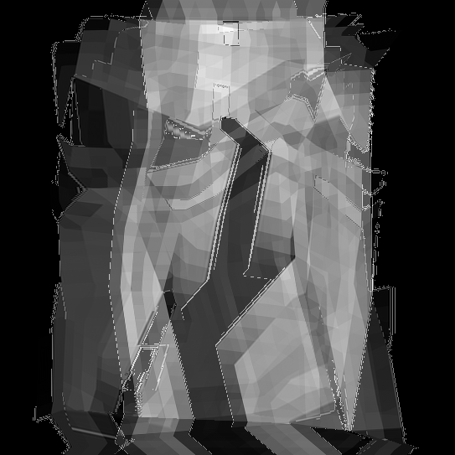
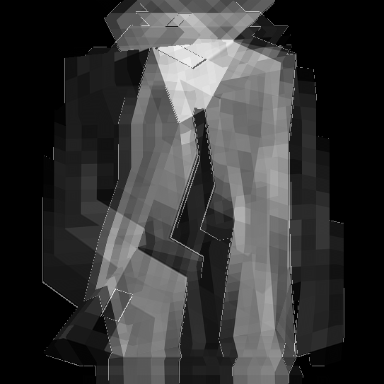
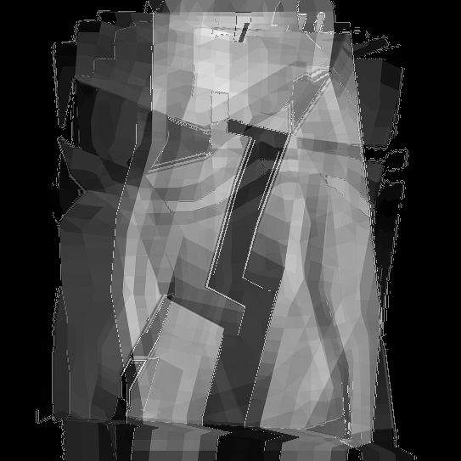
Group 1
Pullover & Coat → Trouser VS. Coat & Pullover → Trouser
5 Pullover
19 Coat
19 Coat
5 Pullover
16 Trouser
16 Trouser
16 Trouser
16 Trouser
16 Trouser
16 Trouser

Slide 6
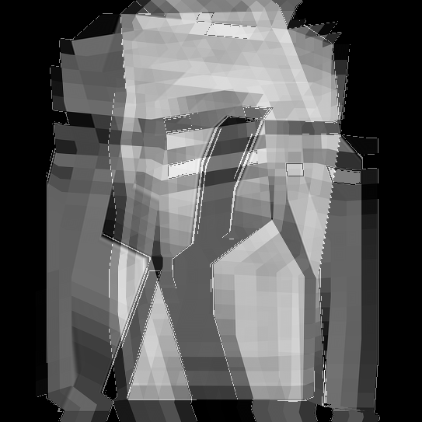
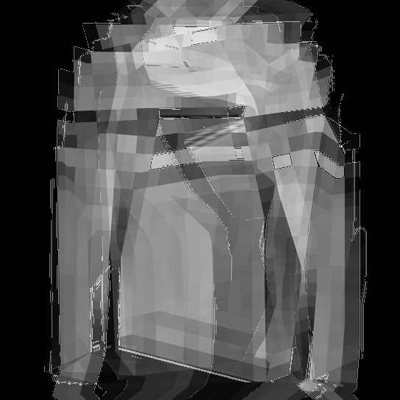
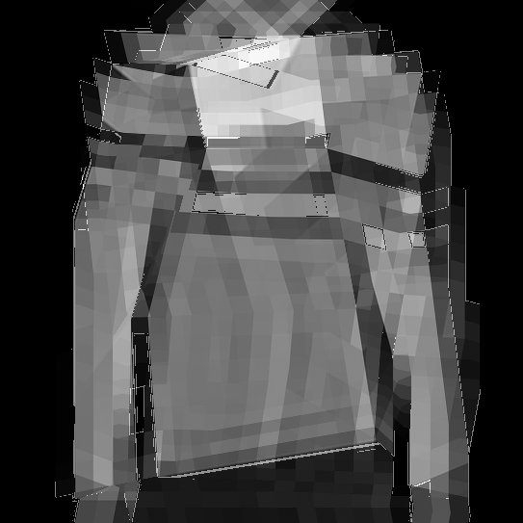
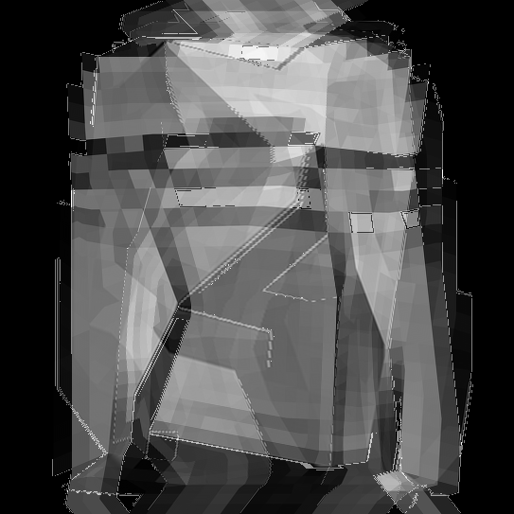
Group 1
Trouser & Coat → Pullover VS. Coat & Trouser → Pullover
16 Trouser
19 Coat
19 Coat
16 Trouser
5 Pullover
5 Pullover
5 Pullover
5 Pullover
5 Pullover
5 Pullover

Slide 7
Morphing Part 2
06/23/22 Slide #10 ~ #19

Slide 8
Process of Morphing
In order to compare the process of image morphing, we divided the experiment into five groups. In each group, three images of different clothing types were selected as the original images to perform the same image morphing twice. Assuming that the three images are pullover A, trouser A, and coat A, we first morphed pullover A to trouser A and 9 transition images would be generated during this process. Then each transition image would be used as the original picture to be morphed to coat A, and another 9 transition images were produced in each morphing process. The 9 images in this ppt are from the original images and the transition image in the middle.
In each experiment if we imagine all the pictures as elements in an 11 by 11 matrix, the first column of pictures originates from the pullover at the top, and the last column of pictures originates from the trouser at the top, which makes the images closer to the left look more like a pullover, the images closer to the right looks more like a trouser, and the images closer to the bottom picture looks more like a coat.

Slide 9
Selection of Images
In the first experiment, the number of clothes is a randomly selected number within 100 according to its pre-set clothes type.
In the second experiment, clothes of the same type but different numbers as in the first experiment, in this case pullover B, trouser B, and coat B, would be selected as the source images for morphing. Although the clothes types used in the two experiments are the same, the clothes numbers that have not been used in the other groups would be given priority, and the images with a larger difference from the clothes picture in the first experiment would also be given priority use as the original images.

Slide 10
Number of the Original Image
Group 1 Pullover & Trouser → Coat
5 16 → 19
27 38 → 24
Group 3 Sneaker & Ankle Boot → Coat
6 11 → 29
14 15 → 96
Group 5 Top & Shirt → Dress
34 32 → 47
4 40 → 81
Group 2 Dress & Sandal → Top
3 8 → 26
49 63 → 48
Group 4 Coat & Sandal → Bag
22 36 → 23
76 82 → 99

Slide 11
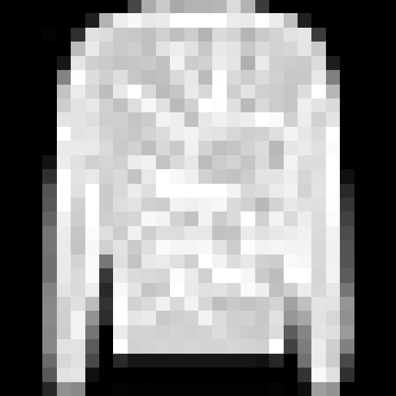
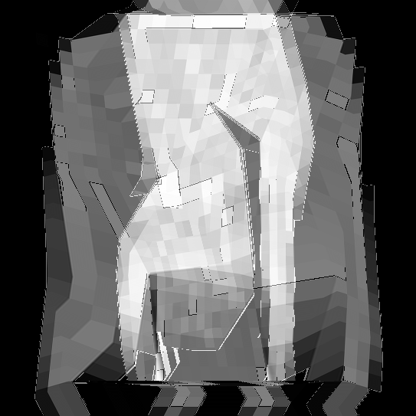
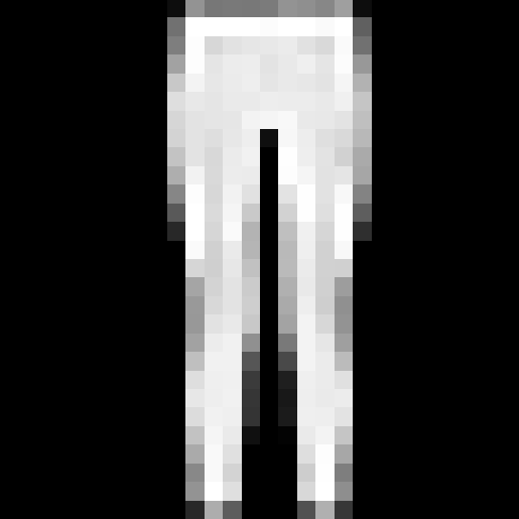
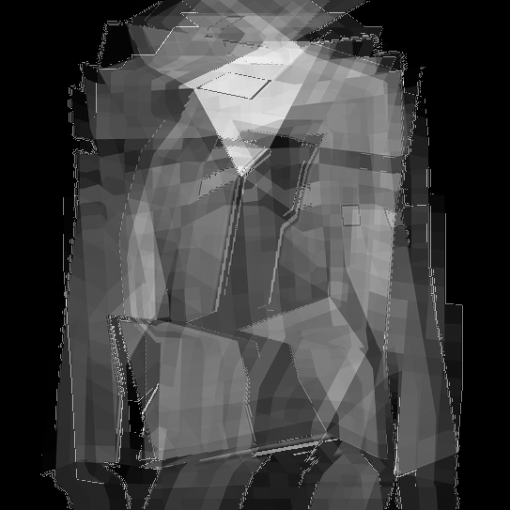
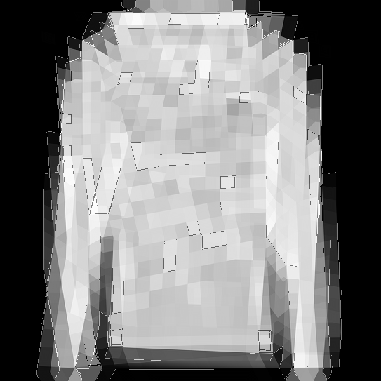
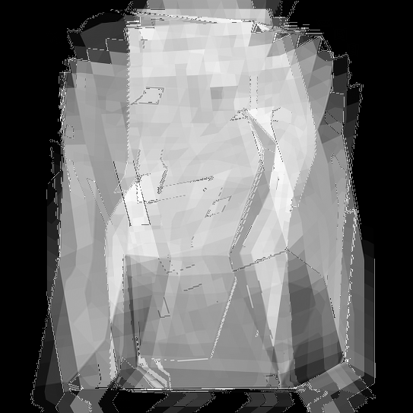
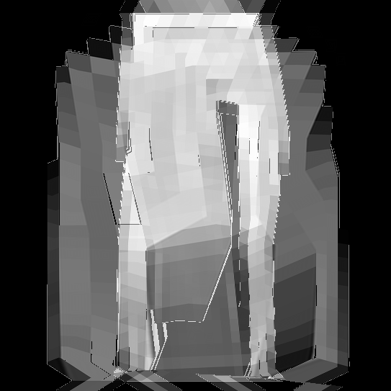
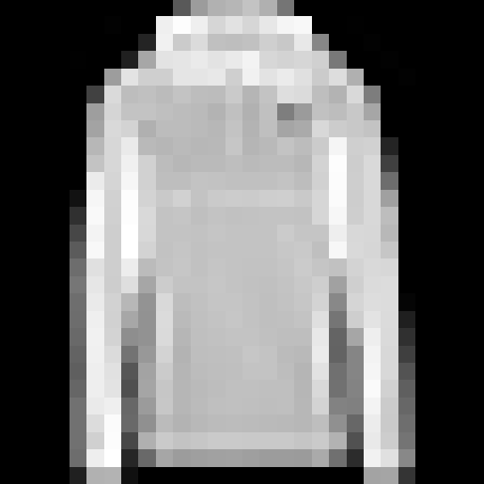
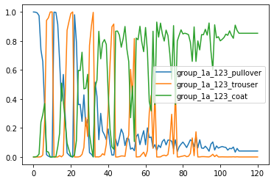
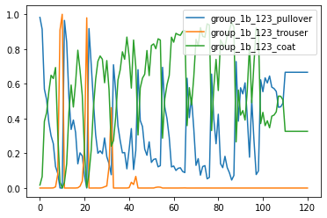
Group 1a VS. Group 1b Pullover & Trouser → Coat

Slide 12
Experiments Result from Group 1
As the images changes from pullover and trouser to coat, the probability of the images being predicted as pullover and trouser decreases, while the probability of being predicted as coat increases. In addition, the probability of pictures being predicted as pullovers and trousers shows periodic changes, this is because the order in which pictures are displayed is from left to right on a top-to-bottom basis, just like the order in which most people read text.
In the second experiment, the probability of being predicted to be a coat did not increase as the pullover morphed into a coat, but rather fluctuated and changed periodically between being predicted to be a coat and a pullover. There may be a variety of factors contributing to this result, including a coat fit that is very close to a pullover. We're not sure exactly what features the computer uses to identify coats. However, a pullover generally does not have zippers, while some coats do. If this is a factor the computer uses to identify them, the coat in the second experiment are undoubtedly more like a pullover.

Slide 13
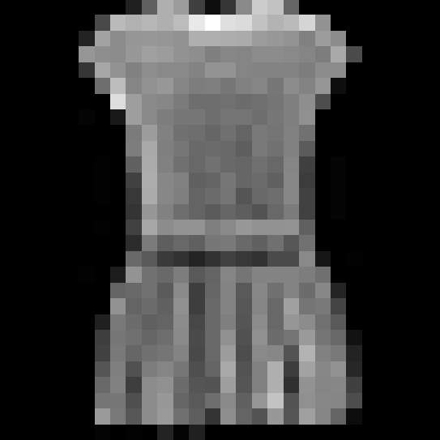
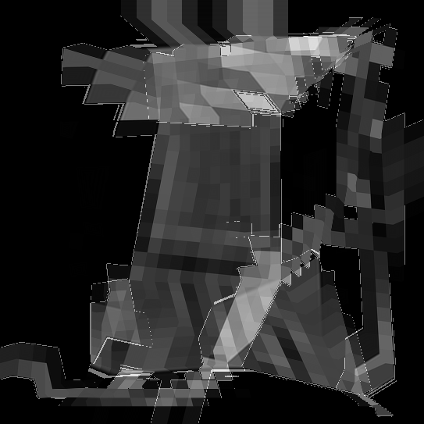
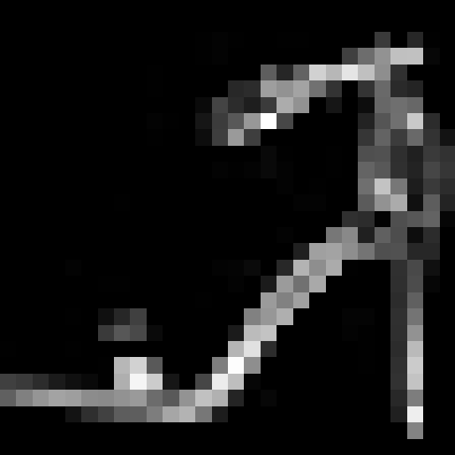
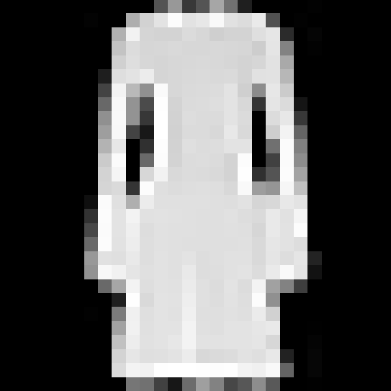
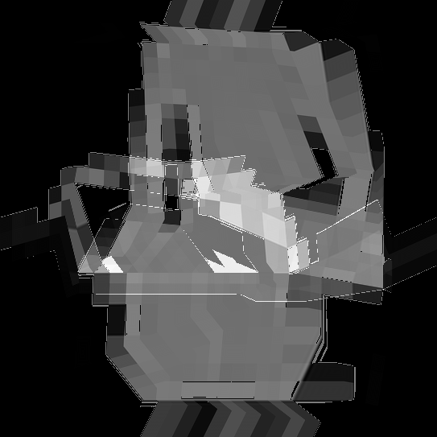
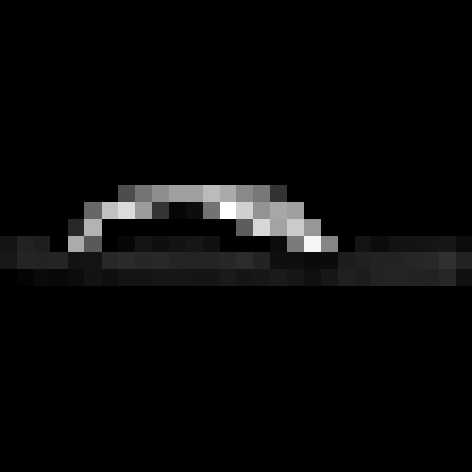
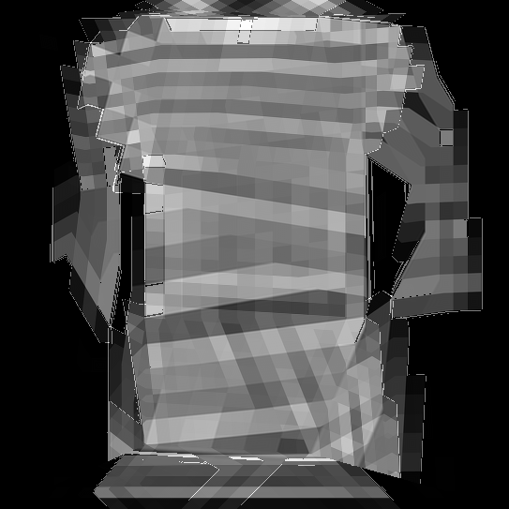
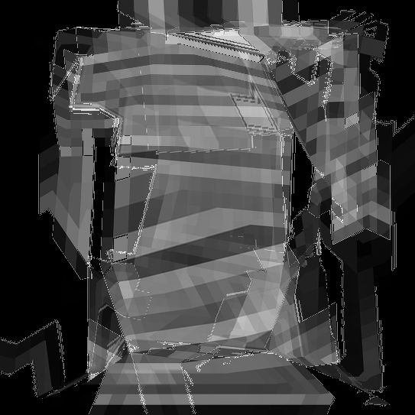
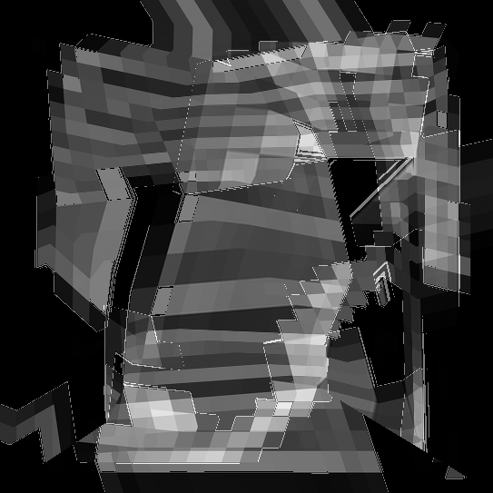
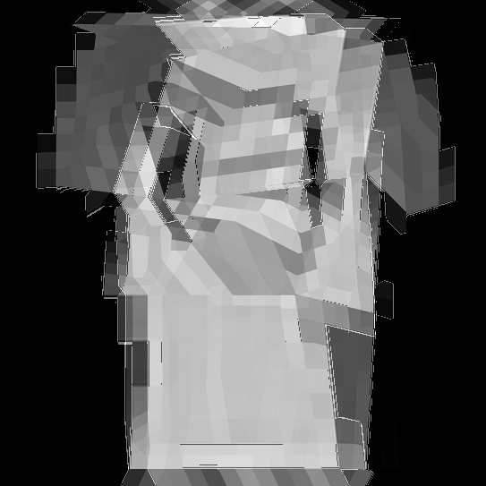
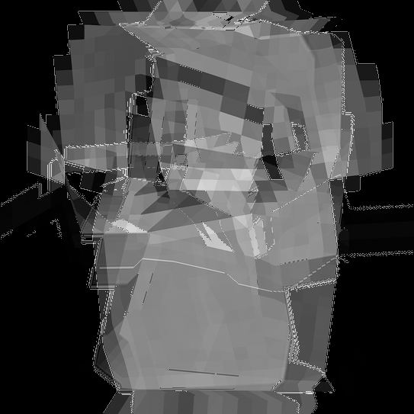
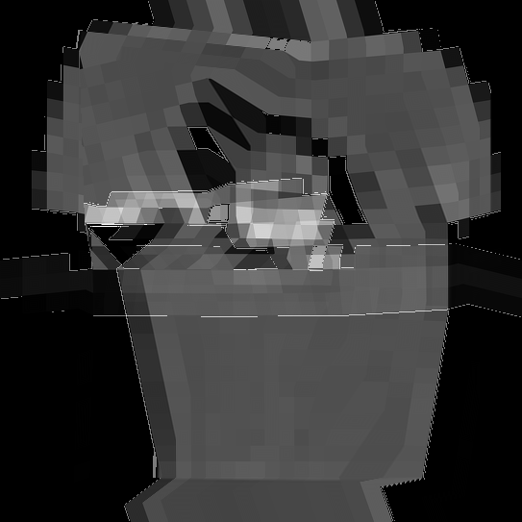
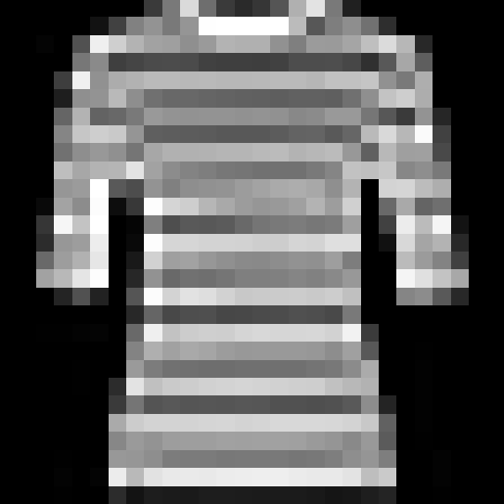
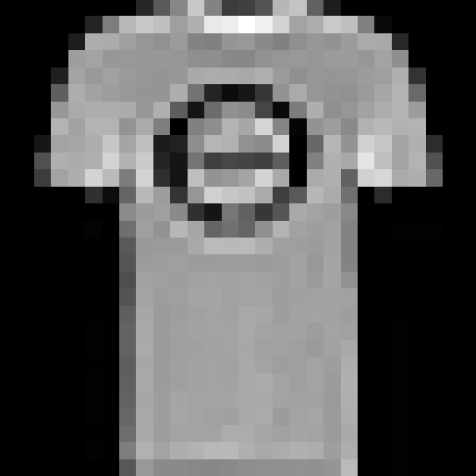
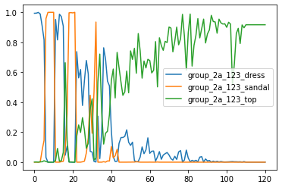
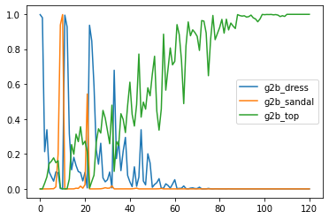
Group 2a VS. Group 2b Dress & Sandal → Top

Slide 14
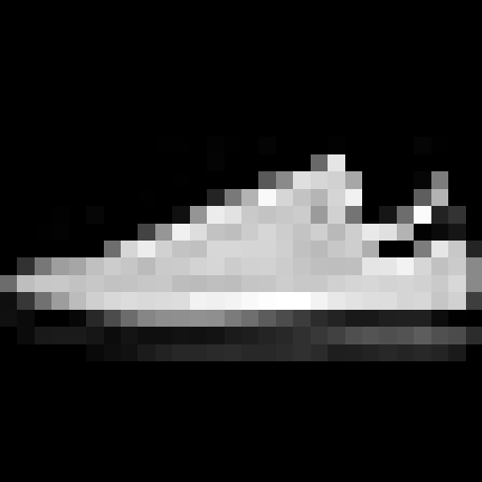
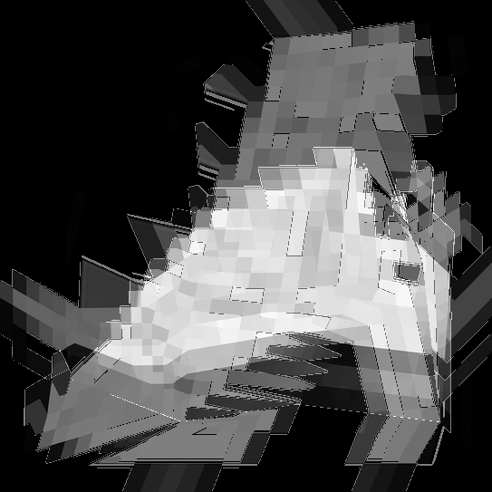
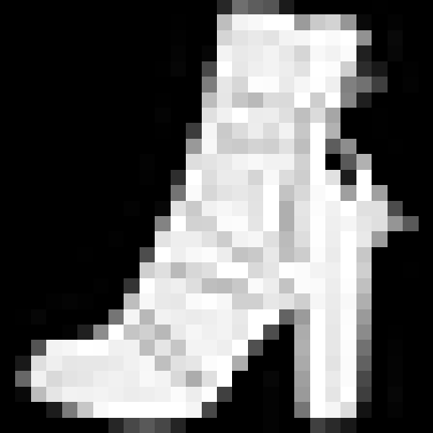
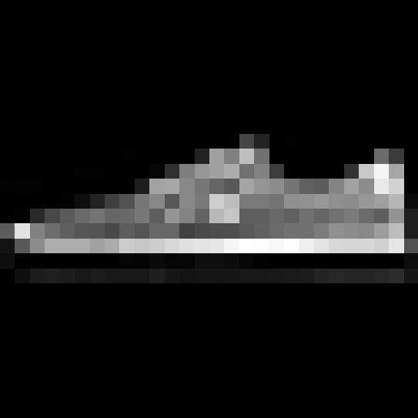












Group 3a VS. Group 3b Sneaker & Ankle Boot → Coat

Slide 15
Experiments Result from Group 2 & 3
The results of the second group of two experiments are very similar, as we expected that as the picture changes, the probability of being predicted to be a dress and a sandal decreases in a periodic way, while the probability of being predicted to be a top increases.
This trend is more obvious and clear in the second experiment. Around the 22th picture, the computer has basically ruled out the possibility of sandals, and has kept the possibility of being predicted to be a sandal as almost 0 until the end. This may be related to the fact that the chosen sandal image occupies less pixel units, so that it is very easy to lose the original shape of the sandals during the process of image morphing. Another reason may be that the computer has a high degree of distinction between sandals and tops, so we can also propose and try to verify the correctness in the future that the two images with more different layouts are easier to be recognized by the computer.
In both experiments in the third group, a noticeable fact is that the probability of being predicted to be a coat did not increase slowly from the beginning in about first 44 images.

Slide 16
















Group 4a VS. Group 4b Coat & Sandal → Bag

Slide 17
















Group 5a VS. Group 5b Top & Shirt → Dress

Slide 18
Experiments Result from Group 4 & 5
The first experimental result in the fourth group is the clearest of the five groups. At about point x = 33 the probability of being predicted as a bag is almost 1, at the same time the probability of being predicted as a sandal or a coat is almost 0, and keep it till the end.
Differently, in the second experiment of the fourth group we found a few interesting points at about 5, 15, 30, 45, and 55, where the three lines basically cross to a single lower probability point, which implies that the picture at this point is so difficult to understand that it is not like any one type of clothing.
By comparing the two experiments in the fifth group, we notice that their main difference is reflected in the probability of being predicted as dress. In the first experiment, the probability of being predicted to be a dress increased relatively smoothly, however, in the second experiment, the fluctuation was quite large and continued to stabilize after point x = 70. This suggests that the transition images of the last column of the 11 by 11 matrix tends to keep the characteristics of shirt in the process of morphing from shirt to dress.

Slide 19






Plot 3D Group 1a & 1b
Pullover Trouser Coat

Slide 20






Plot 3D Group 2a & 2b
Dress Sandal Top

Slide 21






Plot 3D Group 3a & 3b
Sneaker Ankle Boot Coat

Slide 22






Plot 3D Group 4a & 4b
Coat Sandal Bag

Slide 23






Plot 3D Group 5a & 5b
Top Shirt Dress

